Slide 1
Root Mean Square Error (RMSE)

Slide 2
Definition
The root mean square error (RMSE) is a frequently-used measure of the differences between values predicted by a model or an estimator and the values actually observed from the thing being modeled or estimated.

Slide 3
Uses
Model Evaluation Model Comparison Weather Forecasting Stock Market Prediction Engineering Experiments Data Science Analysis Quality Control Regression Models

Slide 4
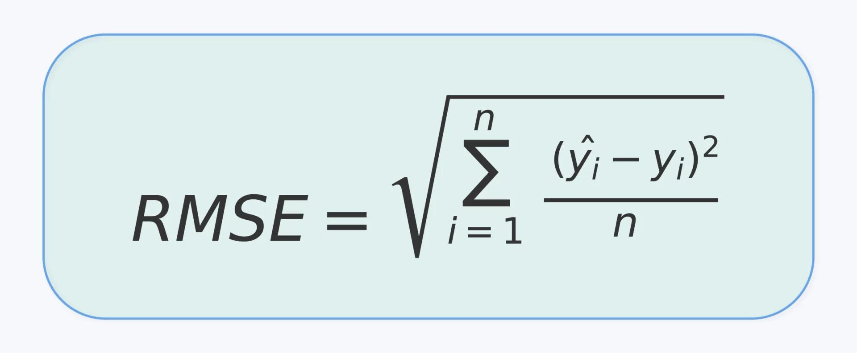
Formula
Yi = Actual value Ŷi= Predicted value n= Total number of observations Σ= Summation of all values

Slide 5
Advantages of Root Mean Square Error (RMSE)
Easy to understand – Simple method to measure prediction error. Widely used – Commonly used in statistics, machine learning, and data analysis. Sensitive to large errors – Large errors are penalized more, which helps improve model accuracy. Same unit as data – RMSE value is in the same unit as the original data, making it easier to interpret. Good for model comparison – Helps compare different prediction models.

Slide 6
Disadvantages of Root Mean Square Error (RMSE)
Sensitive to outliers – Large errors greatly affect the RMSE value. Not always easy to interpret – Without context, RMSE alone may not explain model performance. Depends on data scale – RMSE values change if the scale of data changes. Does not show direction of error – It only shows the magnitude of error, not whether predictions are higher or lower. Less useful for classification problems – Mostly used for regression models, not classification.

Slide 7
Thank you

